Slide 1
Epidemics

Slide 2
Fundamental terms
Diseases vs. Diseases transmitted by a network
Branching Process
The SIR epidemic model
The SIS epidemic Model
5 Worst Computer Viruses of All Time

Slide 3
Fundamental terms
Network
Internet (compared to network)
Epidemic = spread of infectious disease
Neighbors
Worm (will be explained)
Trojan horse (will be explained)

Slide 4
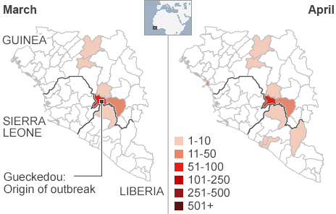
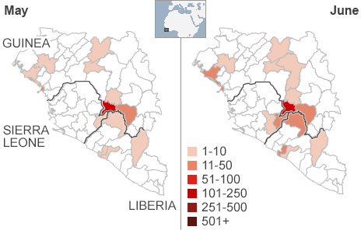
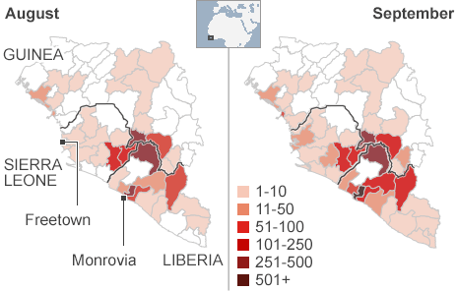
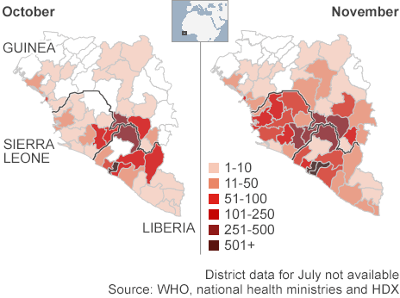
Diseases vs. Diseases transmitted by a network
Ebola
How the virus spread: Ebola death toll:

Slide 5
Types of Diseases
Virus
Worm
Trojan Horse
Melissa (David L. Smith, 1999)- a worm(email worm)

Slide 6
Virus
It is a program which can destroy or cause damage to data stored on a computer system
Virus program must be executed in order to infect a computer system.
Viruses can attach themselves to other programs in order to ensure that this happens.

Slide 7
Computer virus symptoms:
Hardware Troubles – It’s Alive!
computer, printer, etc. started acting up on its own, without you requesting any action by means of keyboard or mouse
No Response – Is Anyone Home?
Slow Performance
Slow Startup
Crashing
Missing files
Extra Files – Who Sat In My Chair?
You may visually notice extra pop ups and extra programs that seem to be running on your computer.

Slide 8
Worm
Worms operate differently to viruses
Worms can spread themselves to other computers without needing to be transferred as part of a host program.
The first time a user may notice the presence of a worm is when the computers memory UNEXPECTEDLY fills up
Mimail.I and Mimail.F

Slide 9
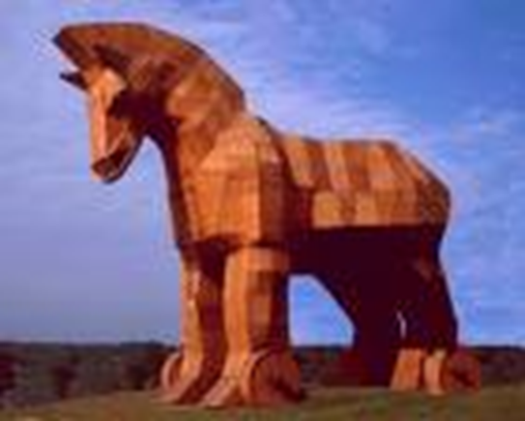
Trojan Horse
Short history lesson
It describes a list of computer threats (malware) that appear to perform good functions, but actually performs malicious functions that allow unauthorized access to the hosting machine
Can open a gateway for hackers

Slide 10
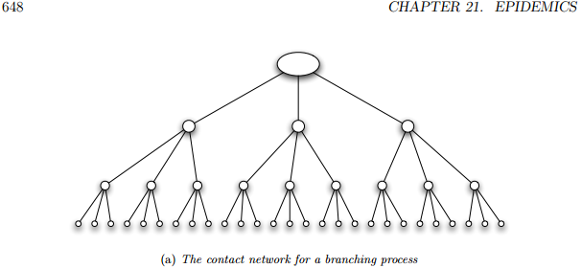
Branching Process
is a model of disease-spreading
It works as follows: (for a ‘sick’ node with k neighbors)
First wave- this k nodes are the first wave of the epidemic
Second wave - k · k = k^2 nodes
Subsequent waves

Slide 11
The SIR epidemic model
can be applied to any network structure
(unlike branching process )
p - the probability of contagion
tI - the length of the infection
How it works:
Initially, some nodes are in the I state and all others are in the S state.
Each node v that enters the I state remains infectious for tI steps .
During each of these tI steps, v has a probability p of passing the disease to each of its susceptible neighbors.
After tI steps, node v is no longer infectious or susceptible to further bouts of the disease; we describe it as removed (R).

Slide 12
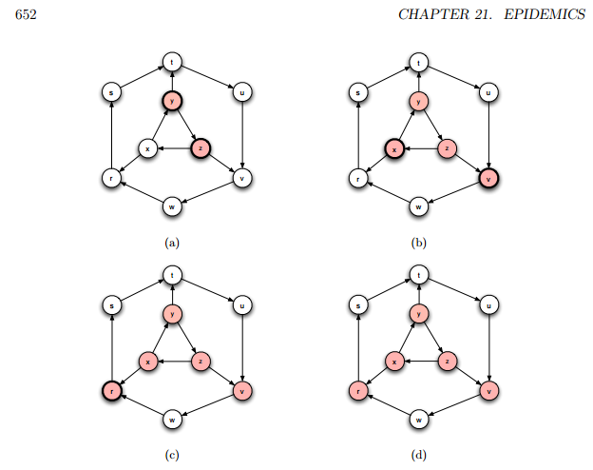
This describes the full model
we refer to it as the SIR model, after the three disease states that nodes experience.
after being infected, a node is removed either because it has acquired lifetime immunity or because the disease has killed it

Slide 13
The SIS epidemic model
In an SIS epidemic, nodes can be infected, recover, and then be infected again.
The mechanics of the model follow the SIR process very closely.
(Aside from the lack of an R state)
How it works:
Initially, some nodes are in the I state and all others are in the S state
Each node v that enters the I state remains infectious for tI steps
During each of these tI steps, v has a probability p of passing the disease to each of its susceptible neighbors.
After tI steps, node v is no longer infectious, and it returns to the S state.

Slide 14
In fact it is possible to represent some of the basic variants of the SIS model as special cases of the SIR model
An SIS epidemic can be represented in the SIR model by creating a separate copy of the contact network for each time step: a node at time t can infect its contact neighbors at time t + 1.
To represent the SIS epidemic using the SIR model, we use a “‘time-expanded” contact network

Slide 15
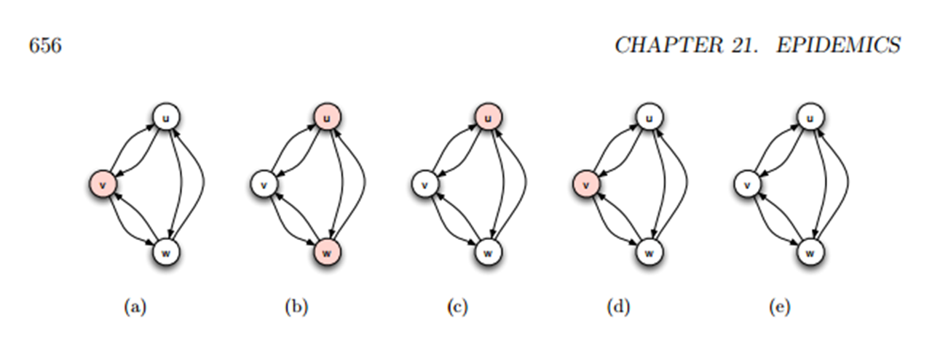
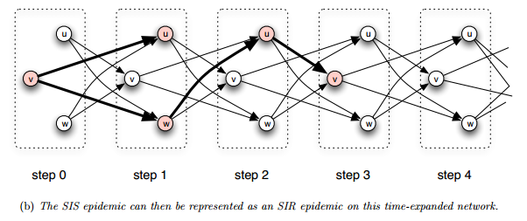
SIS epidemic:
SIS as an SIR epidemic:

Slide 16
5 Worst Computer Viruses* of All Time

Slide 17
MYDOOM(2004)
managed to shut down Google for almost a day
Damages: $38,000,000,000
PC infected: 2,000,000
What was it- a worm
How it worked
How it spread

Slide 18
SOBIG.F(2003)
Damages: $37,100,000,000
PC infected: 2,000,000
What was it
How it worked
How it spread

Slide 19
ILOVEYOU(2000)- Not very loving
Damages: $15,000,000,000
PC infected: 500,000
What was it
How it worked
How it spread

Slide 20
Code Red(2001)
Damages: $2,600,000,000
PC infected: 1,000,000
What was it
How it worked
How it spread

Slide 21
SLAMMER(2003)
Damages: $1,200,000,000
PC infected: 200,000
What was it
How it worked
How it spread

Slide 22
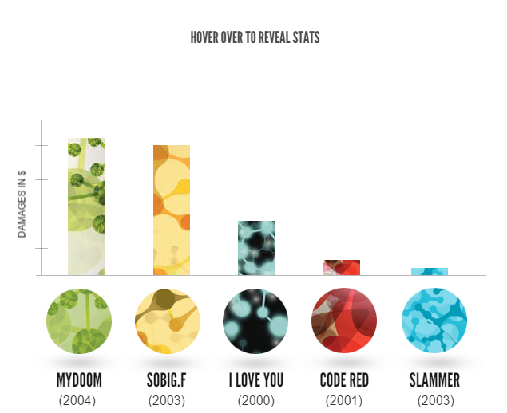

Slide 23
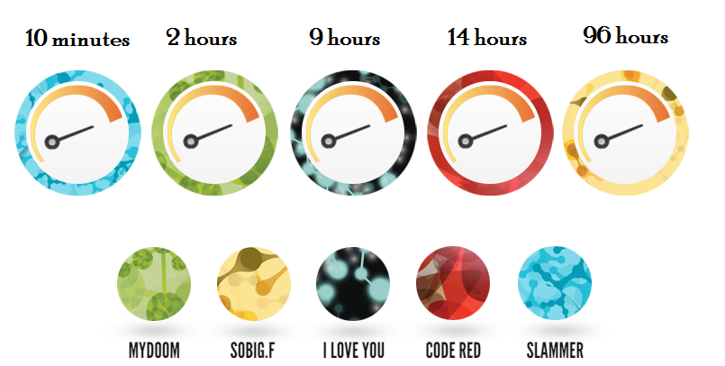
The viruses spread in :

Slide 24
How it really works:
https://www.youtube.com/watch?v=ZqkFfF5kAvw

Slide 25
Hope you enjoyed

